Slide 1
Battle of the Neighbourhoods
Applied Data Science
Capstone Project
By: Fahamida Haque

Slide 2
Outline
Intoduction and Objectives
Data
Methodology
Results
Discussion
Drawbacks
Conclusion

Slide 3
Introduction
Coffee is one of the most widely consumed beverages in the world
A survey found that almost three quarters of Canadians have consumed coffee in the last day
Our client is looking to open his coffee shop in Toronto
Toronto is also an international center of business, culture, and the arts and is one of the most multicultural cities in the world
The ideal location for this new business would be an area with minimal competition and close to the city center

Slide 4
Data
Wikipedia – to obtain postal codes for the city of Toronto
Geocoder Package – used to find the latitudes and longitudes of each neighbourhood
Foursquare API – used to search for the venues in each neighbourhood

Slide 5
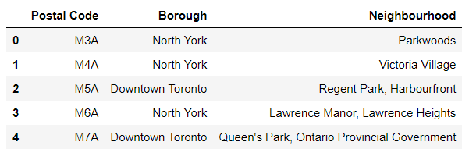
Methodology- Data Cleansing
Postal codes for the city of Toronto is obtained from Wikipedia.
Wikipedia table is extracted using Beautiful Soup.
Data is saved in a Pandas data frame.
Discard rows without values for borough
If borough assigned but neighbourhoods is , neighbourhoods = borough

Slide 6
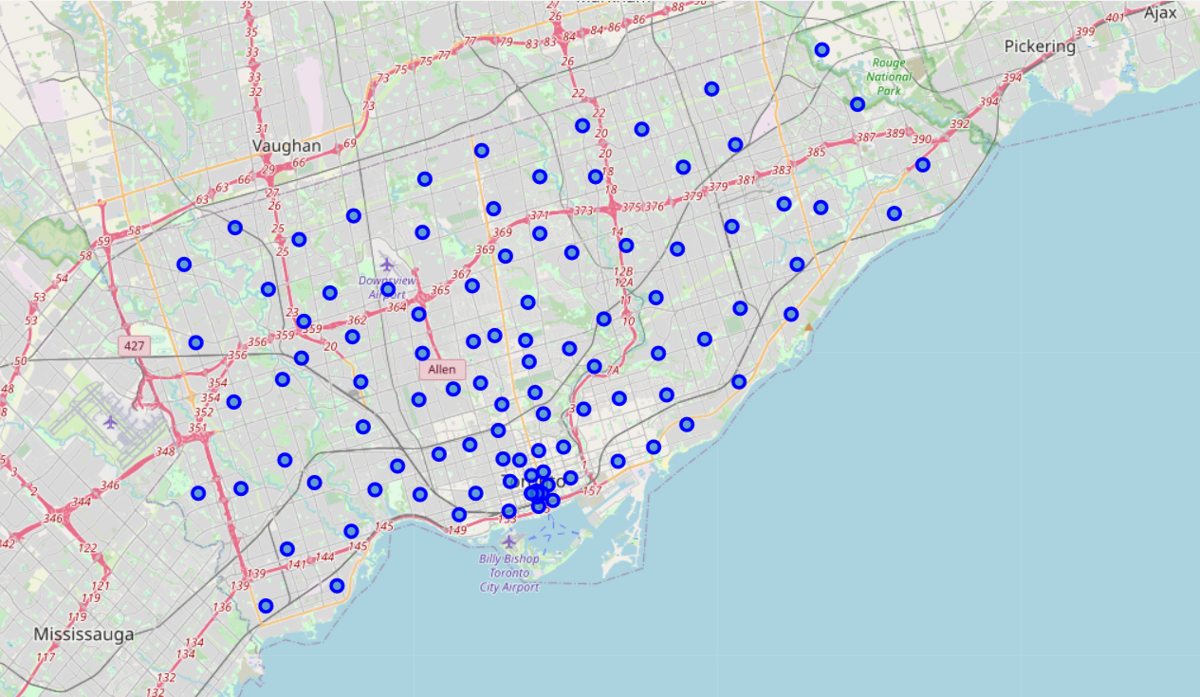
Methodology – Data Exploration
Use geocoder to get geographical coordinates for each neighbourghood
Plot the neighbourghoods using Folium
Use Foursquare Api to search for 500 venues within 1 km radius for each neighbourhood

Slide 7
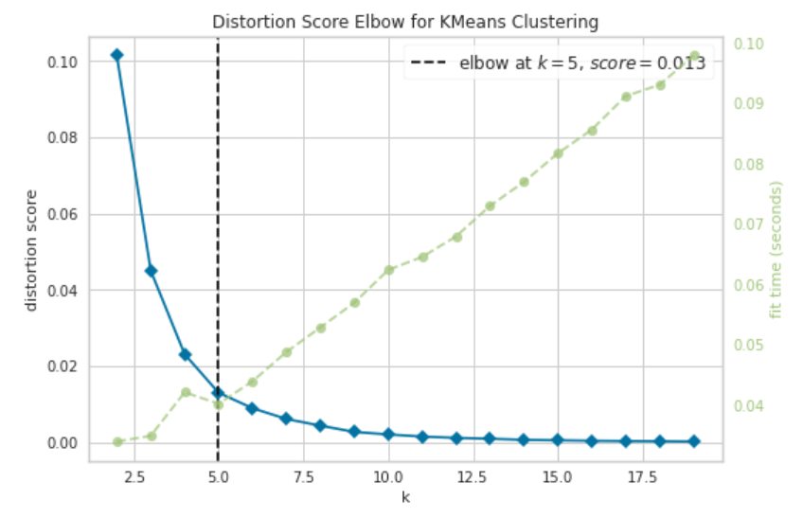
Methodology – Machine Learning
Get a list of all the venues
Find the unique venue categories
Find average mean of each category in each neighbourhood
use the k-means clustering method to cluster the neighbourhoods based on their average mean
Use the elbow point method to find number of clusters
K = 5

Slide 8
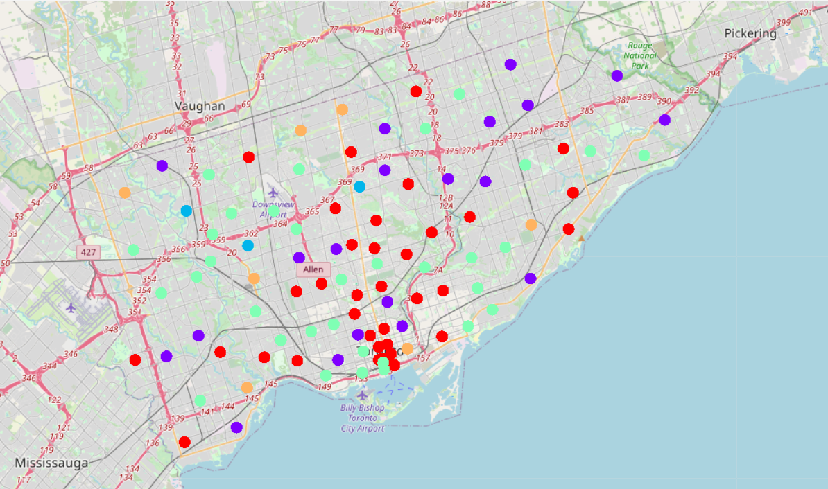
Methodology – Data Analysis
Plot all the cluster labels from each neighbourhood onto the map of Toronto.
Plot the number of neighbourhoods per cluster
Plot the average number of coffee shops in each cluster
Analyze the plots and choose a cluster with a low density of coffee shops
Search cluster to find a neighbourhood that is closest to the city’s downtown

Slide 9
Results
Cluster 1 (k = 0) is represented by the red points
Cluster 2 (k = 1) are represented by the points
Cluster 3 (k = 2) is represented by the blue points
Cluster 4 (k = 3) is represented by the purple points
Cluster 5 (k = 4) is represented by the orange points

Slide 10
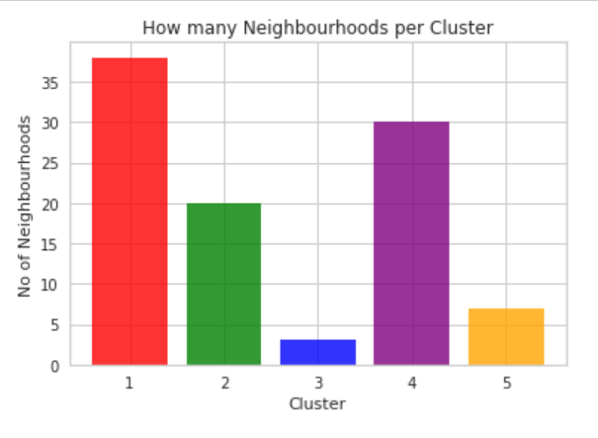
Results - Continued
Cluster 1 - 38 neighbourhoods
Cluster 4 – 30 neighbourhoods
Cluster 2 – 20 neighbourhoods
Cluster 5 – 7 neighbourhoods
Cluster 3 – 3 neighbourhoods

Slide 11
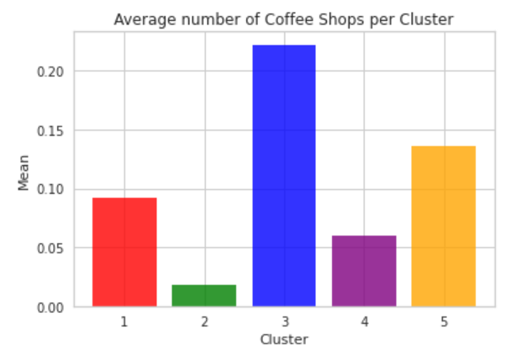
Results - Continued
Cluster 2 (0.018)
Cluster 4 (0.059)
Cluster 1 (0.092)
Cluster 5 (0.136)
Cluster 3 (0.222)

Slide 12
Results - Continued
We can see that clusters 1, 2 and 4 have the lowest density of coffee shops with the greatest number of neighbourhoods
Clusters 3 and 5 have the highest density of coffee shops with the least number of neighbourhoods
Our coffee shop will be either in cluster 1, 2 or 4 since a low density of coffee shops indicates that there will be less competition with similar businesses
Clusters 1, 2 and 4 contain neighbourhoods in Downtown Toronto
Ideal locations from cluster 1, near Ryerson and central Bay street
Ideal locations from cluster 2 include Adelaide and King
Ideal locations from cluster 4 include St James and Rosedale

Slide 13
Discussion
All data used in our analysis comes from the Foursquare API
Using more databases would have resulted in a more complete recommendation
Elimination of some neighbourhoods during data cleansing, excluded them from the analysis
Analyzing more neighbourhoods would result in a better recommendation of our final location

Slide 14
Conclusion
We found that the downtown neighbourhoods in clusters 1, 2 and 4 are the best locations to open the coffee shop
Ideal locations from cluster 1, near Ryerson and central Bay street
Ideal locations from cluster 2 include Adelaide and King
Ideal locations from cluster 4 include St James and Rosedale

